Slide 1
HEART ATTACK PREDICTION
Under the guidance of
Ms. MANALI PATIL
Email:manalivikas.patil@anudip.org
Presented by
C.Shasikala
Batch Code:ANP-C7333,
STUDENT ID:AFO366834

Slide 2

Contents
Abstract
Introduction
Objective
Applications
Data Collection
Software Requirements
Analysis of heart attack
Applications
Conclusion

Slide 3
Abstract
Heart disease remains a leading cause of mortality globally, underscoring the critical need for accurate and timely prediction tools. This project aims to develop a robust heart attack prediction model leveraging data analytics techniques implemented in Python.
Through the analysis of a comprehensive dataset containing various clinical and demographic features, including age, gender, cholesterol levels, blood pressure, and lifestyle factors, we predict the likelihood of a heart attack occurrence .
By harnessing the power of Python libraries such as pandas, scikit-learn, and matplotlib, this project demonstrates the effectiveness of data analytics in improving healthcare outcomes through proactive risk assessment and intervention strategies.

Slide 4

Introduction
Heart attacks, also known as myocardial infarctions, represent a significant global health challenge, contributing to millions of deaths each year.
Characterized by the sudden blockage of blood flow to the heart muscle, heart attacks can have devastating consequences if not promptly treated.
In the realm of modern healthcare, data analytics has emerged as a powerful tool for revolutionizing how we approach the prediction of heart attacks.

Slide 5
Objective
The main objective of heart attack prediction is to identify individuals at high risk of experiencing a myocardial infarction (MI) or heart attack before it occurs.
By leveraging various data sources and analytical techniques, healthcare providers can tailor interventions to each individual's unique risk profile, optimizing resource allocation and improving outcomes.
Early detection of heart disease is essential for starting treatment. The longer a blockage is left untreated, the more damage occurs.
When having a heart attack, person may experience pain, pressure, heaviness or tightness in one or more parts of your upper body, including your chest.

Slide 6
Data Collection
Kaggle is a data science competition platform where users can find datasets to use, publish datasets, collaborate with other data scientists, and enter competitions.
GitHub has several free Excel datasets, including workbooks for Power BI and Power BI Desktop, as well as projects that help with data analysis.
A CSV (Comma Separated Values) file is a simple file format for storing tabular data. Each line of a CSV file is a data record, and each record contains one or more fields separated by commas.

Slide 7
Software Requirements
Python:
Python serves as the primary programming language due to its extensive libraries for data
manipulation, analysis, and machine learning. Popular libraries for heart attack prediction
include:
Pandas: For data manipulation and preprocessing.
NumPy: For numerical operations and array manipulation.
Scikit-learn: For machine learning algorithms and model evaluation.
Matplotlib and Seaborn: For data visualization.
Jupyter Notebook or Jupyter Lab:
Jupyter Notebook is a popular open-source web application that allows you to create and
share documents containing live code, equations, visualizations, and narrative text

Slide 8
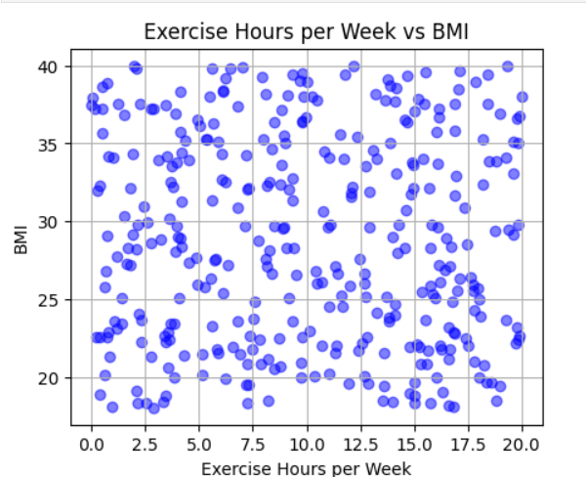
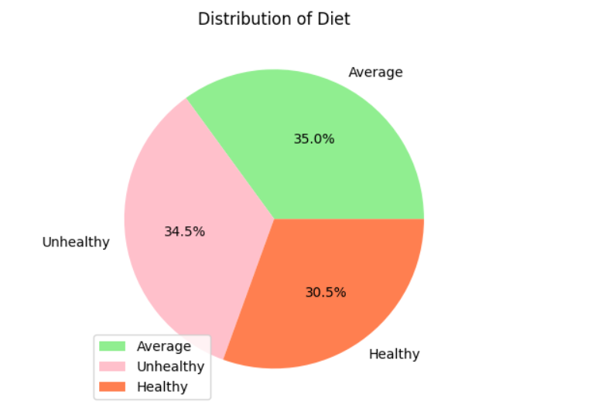
Analysis of Heart attack

Slide 9
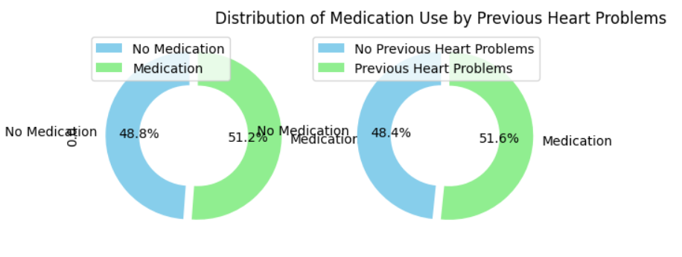

Slide 10
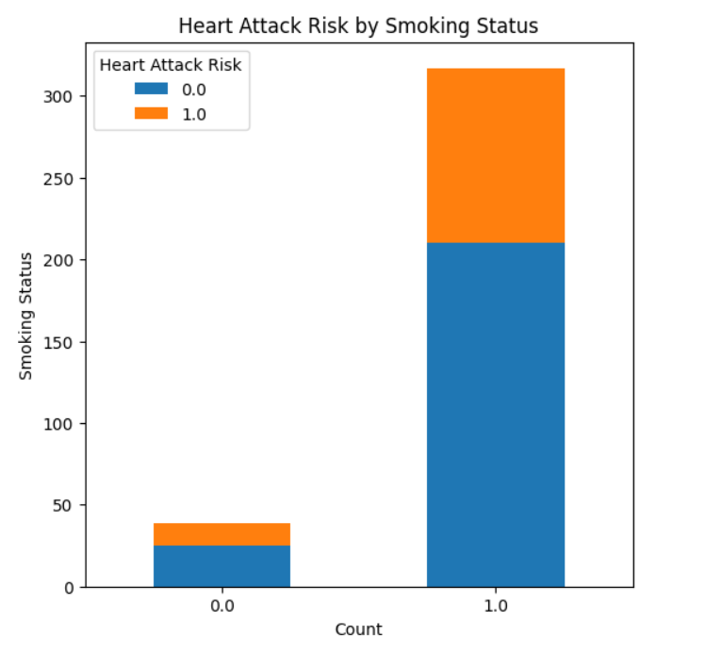

Slide 11
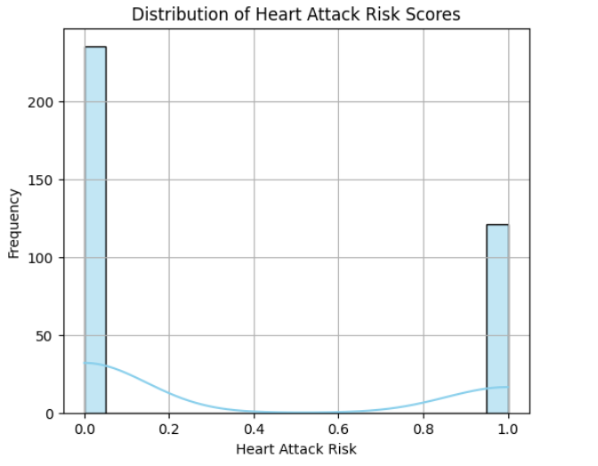

Slide 12
Applications
Clinical Decision Support Systems
Telemedicine and Remote Monitoring
Healthcare Resource Allocation
Medical Education and Training
Pharmaceutical Research and Development

Slide 13
Conclusion
The heart attack prediction model developed using data analytics with Python demonstrates promising results in identifying individuals at risk of experiencing a cardiac event.
Through the analysis of various risk factors such as age, gender, blood pressure, cholesterol levels, and other pertinent health indicators, the model provides valuable insights into the likelihood of a heart attack occurrence.
Overall, the heart attack prediction model represents a significant advancement in leveraging data analytics for proactive healthcare management, offering the potential to improve patient outcomes and reduce the burden of cardiovascular diseases on individuals and healthcare systems alike.

Slide 14
THANK YOU

